Slide 1




Slide 2

PROBLEMS ON BOATS AND STREAMS

Slide 3
TSD- BOATS AND STREAMS
A boat is said to go downstream if it is moving along the direction of the stream. The net speed of the boat in this case is called downstream speed.
A boat is said to go upstream if it is moving in the direction opposite to the direction of the stream. The net speed of the boat in this case is called upstream speed.
Let the speed of the boat in still water is 'b' km/hr and the speed of the stream is 'w' km/hr. When the boat goes downstream then the speed will be (b + w) km/hr as in this case the water will take the boat along with it.
When the boat goes upstream then the speed will be (b - w) km/hr as in this case the water will offer resistance to the boat

Slide 4
TSD- BOATS AND STREAMS
Let the downstream speed = d = b + w ……….(i)
Then the upstream speed = u = b – w ………(ii)
Adding the two equations, we get 2b = d + u.
⇒ b = (d+u) / 2 which gives the speed of the boat in terms of downstream and upstream speed. Subtracting the equation (i) and (ii), we get d – u = 2w ⇒ w = (d-u) / 2 which gives the speed of the stream in terms of downstream and upstream speed. You should remember these boats and streams formulas.

Slide 5


TSD- BOATS AND STREAMS
Suppose a man can row a boat at a speed of r km/hr in still water and covers the same distance up and down in a stream while a stream flows at a speed of s km/hr. His average speed will be :
A man rows downstream by covering a certain distance in p1 hours and returns the same distance upstream in p2 hours. If the speed of the stream is s km/hr, then the speed of the man in still water will be :
A man takes same number of times say m times to row upstream as to row downstream a river. If the speed of the man is r km/hr and the speed of the stream is s km/hr, then

Slide 6
TSD- BOATS AND STREAMS
If it takes “t” hours for a boat to reach a point in still water and comes back to the same point then, the distance between the two points can be calculated by Distance = {(u2-v2) × t} / 2u, where “u” is the speed of the boat in still water and “v” is the speed of the stream
If it takes “t” hours more to go to a point upstream than downstream for the same distance, the formula for distance will be: Distance = {(u2-v2) × t} / 2v, where “u” is the speed of the boat in still water and “v” is the speed of the stream
If a boat travels a distance downstream in “t1” hours and returns the same distance upstream in “t2” hours, then the speed of the man in still water will be: Speed of Man in Still Water = [v × {(t2+t1) / (t2-t1)}] km/hr, where“v” is the speed of the stream

Slide 7
Question: Q01
A man takes 20 minutes to row 12 km upstream which is a third more than the time he takes on his way downstream. What is his speed in still water?
41 km/hr
36 km/hr
42 km/hr
45 km/hr
Answer:C
Notes:
A

Slide 8
Explanation: Q01
Let the speed in still water = x km/hr. Takes 20 min. to row 12 km upstream ⇒ speed of u/s = 36 km/hr. Also, time taken for u/s is 1/3 more than for d/s.
∴ distance covered in d / s will be 1/3 more.
Hence distance covered by man for d / s in 20 min. = 12 × (12/3) = 16km.
So speed of d / s = 48 km/hr.
∴ x + y = 48 and x – y = 36 ⇒ x = 42 km/hr.

Slide 9
Question: Q02
How long will it take to row 20 km upstream if one can row 10 km in 10 minutes in still water and the same distance in 8 minutes with the stream?
12 min
13.33 min
24 min
26.67 min
Answer:D
Notes:
B

Slide 10
Explanation: Q02
Let x be the speed of man in still water and y be the speed of stream.
∴ Speed of man (x) = 60 km/hr and speed of downstream = 75 km/hr. ∴ Speed of stream = 15 km/hr.
Hence upstream speed = 60 – 15 = 45 km/hr.
So time taken to cover 20 km = 20/45*60 = 26.67min.

Slide 11
Question: Q03
A boat makes a return journey from point A to point B and back in 5 hours 36 minutes. One way it travels with the stream and on the return it travels against the stream. If the speed of the stream increases by 2 km/hr, the return journey takes 9 hours 20 minutes. What is the speed of the boat in still water? (The distance between A and B is 16 km.)
5 km/hr
3 km/hr
7 km/hr
9 km/hr
Answer:C
Notes:
10, 30, 90, 270 and 810

Slide 12
Explanation: Q03
Let x be speed of u / s and y be the speed of d / s.
∴ (16/x) + (16/y) = (28/5) and 16/(y+2) + 16/(x-2) = 28/3
Solving these 2 equations, we get x = 4km/hr and y = 10km/hr
∴ speed of boat in still water = (4+10) / 2 = 7km/hr.

Slide 13
Question: 04
A boat travels from point A to B, a distance of 12 km. From A it travels 4 km downstream in 15 minutes and the remaining 8 km upstream to reach B. If the downstream speed is twice as high as the upstream speed, what is the average speed of the boat for the journey from A to B?
10(2/3)km/hr
9.6 km/hr
11.16 km/hr
10.44 km/hr
Answer:B
Notes:
10, 30, 90, 270 and 810

Slide 14
Explanation: Q04
4 km downstream is covered in 15 min. ∴ speed of downstream = 16 km/hr. So speed of upstream = 8km/hr. Total time taken for downstream journey = 15 min (given). Now total time taken for upstream journey = 8/8 = 1 hr = 60 min. Hence total time taken from A to B = 15 + 60 = 75 min. As average speed = Total distance /total time, so average speed from A to B = (12/75)*60 = 48/5 = 9.6kmph.

Slide 15
Question: Q05
A man rows ‘k’ km upstream and back again downstream to the same point in H hours. The speed of rowing in still water is s km/hr and the rate of stream is r km/hr. Then
(s²-r²) =2sk /H
(r + s) = kH / (r -s)
rs = kH
None of the above
Answer:A
Notes:
D

Slide 16
Explanation: Q05
Time taken to cover total distance = H hrs.
Speed of upstream = s - r. Speed of downstream = s + r.
∴ k / (s + r) + k / (s - r) = H ⇒(s²-r²) =2sk /H

Slide 17
Question: Q06
A man rows 24 km upstream in 6 hours and a distance of 35 km downstream in 7 hours. Then the speed of the man in still water is
4.5 km/hr
4 km/hr
5 km/hr
5.5 km/hr
Answer:A
Notes:
C

Slide 18
Explanation: Q06
Speed of upstream = 24 / 6 = 4 km / hr. Speed of downstream = 35 / 7 = 5km / hr.
∴ Speed of man in still water = (4 + 5) / 2 = 4.5 km / hr.
Notes:
Solution: The nth term of GP is given by:
2, 4, 8,….
Here, a = 2 and r = 4/2 = 2
an = arn-1
Therefore,
a10 = 2 x 210 – 1
= 2 × 29
= 1024

Slide 19
Question: Q07
A boat goes 12 km upstream in 48 minutes. The speed of stream is 2 km/hr. The speed of boat in still water is
15 km/hr
16 km/hr
17 km/hr
18 km/hr
Answer:C
Notes:
A

Slide 20
Explanation: Q07
12 km upstream in 48 min. ⇒ it will cover 15 km in 1 hr. Speed of stream = 2 km / hr.
∴ Speed of boat in still water = 15 + 2 = 17 km / hr.

Slide 21
Question: Q08
A motorboat can travel at 5 km/hr in still water. It travelled 90 km downstream in a river and then returned, taking altogether 100 hours. Find the rate of flow of the river.
3 km/hr
3.5 km/hr
2 km/hr
4 km/hr
Answer:D
Notes:
C

Slide 22
Explanation: Q08
Speed of boat in still water = x = 5 km/hr.
Let rate of flow of river = y km/hr. ∴ Speed of u/s = 5- y and speed of d / s = 5 + y
∴ 90/(5+y) + 90/(5-y) = 100 ⇒ y = 4 km/hr.

Slide 23
Question: Q09
A boatman can row 2 km against the stream in 20 minutes and return in 10 minutes. Find the rate of flow of the current.
2 km/h
1 km/h
3 km/h
5 km/h
Answer:C
Notes:
B

Slide 24
Explanation: Q09
Let x be the speed of man in still water and y be the speed of current.
Speed of d / s = (2 / 10) × 60 = 12 km / hr. Speed of u / s = (2 / 20) × 60 = 6 km / hr.
∴ rate of current = (12 - 6) / 2 = 3 km/hr.

Slide 25
Question: Q10
A man can row 30 km upstream in 6 hours. If the speed of the man in still water is 6 km/hr, find how much he can row downstream in 10 hours.
70 km
140 km
200 km
250 km
Answer:A
Notes:
C

Slide 26
Explanation: Q10
Speed of upstream = 30 / 6 = 5 km / hr. Speed of man in still water = 6 km / hr.
∴ Speed of current = 6 - 5 = 1 km / hr. So speed of downstream = 6 + 1 = 7 km / hr.
∴ Distance traveled in 7 hrs = 10 * 7 = 70 km.

Slide 27
Question: Q11
A boat can travel with a speed of 13 km/hr in still water. If the speed of the stream is 4 km/hr, find the time taken by the boat to go 68 km downstream.
2 hours
3 hours
4 hours
5 hours
Answer:C
Notes:
A

Slide 28
Explanation: Q11
Speed downstream = (13 + 4) km/hr = 17 km/hr.
Time taken to travel 68 km downstream = 68/17 = 4hrs

Slide 29
Question: Q12
A boat running upstream takes 8 hours 48 minutes to cover a certain distance, while it takes 4 hours to cover the same distance running downstream. What is the ratio between the speed of the boat and speed of the water current respectively?
2 : 1
3 : 2
8 : 3
Cannot be determined
Answer:C
Notes:
B

Slide 30
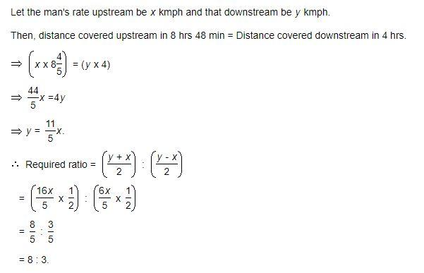
Explanation: Q12

Slide 31
Question: Q13
A motorboat, whose speed in 15 km/hr in still water goes 30 km downstream and comes back in a total of 4 hours 30 minutes. The speed of the stream (in km/hr) is:
4
5
6
10
Answer:B
Notes:
B

Slide 32

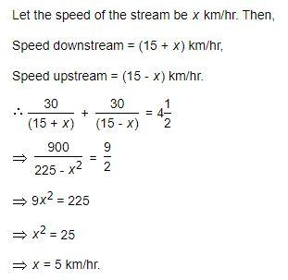
Explanation: Q13

Slide 33
Question: Q14
In one hour, a boat goes 11 km/hr along the stream and 5 km/hr against the stream. The speed of the boat in still water (in km/hr) is:
3 km/hr
5 km/hr
8 km/hr
9 km/hr
Answer:C
Notes:
A

Slide 34
Explanation: Q14
Speed in still water= 0.5 (11 + 5) kmph = 8 kmph.

Slide 35
Question: Q15
A boat running downstream covers a distance of 16 km in 2 hours while for covering the same distance upstream, it takes 4 hours. What is the speed of the boat in still water?
4 km/hr
6 km/hr
8 km/hr
Data inadequate
Answer:B
Notes:
10, 30, 90, 270 and 810

Slide 36
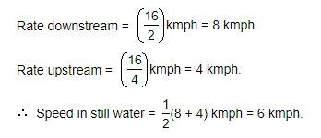
Explanation: Q15

Slide 37

https://learn.codemithra.com

Slide 38




THANK YOU
+91 78150 95095
codemithra@ethnus.com
www.codemithra.com

